Slide 1
“How-To-Use This Slide Deck”
IMPORTANT! PLEASE DELETE THIS SLIDE BEFORE OFFICIAL USE!
This slide deck should be viewed as a selection of PRTG and Paessler related content, to be customized for your intended audience. In other words, feel free to use or hide individual slides (or groups of slides) and re-arrange the presentation order as appropriate.
We politely request you do not make any changes to the Paessler Corporate Identity, including the look and feel, slide template, graphics, logos, trademarks etc.
There is a slide towards the end where you can add your own corporate information and your unique download tracking URL for prospects.
This is a sales-focused presentation, designed primarily for a commercial audience. For a more technically advanced slide deck, please contact your partner account manager or email partners@paessler.com
Notes:
Please don’t forget to hide or delete this slide prior to use!

Slide 2
PRTG – Simplify Your Day

Slide 3
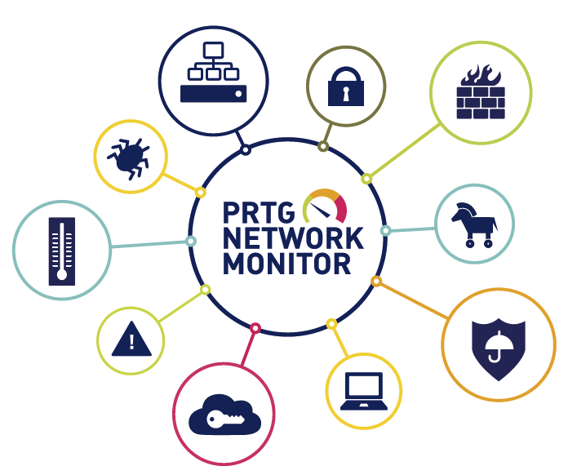

Notes:
Start this presentation by asking audience about the daily struggles they experience within their network and what sort of changes they would like to see by deploying a monitoring tool. How do they keep on top of things such as security threats, networking issues, uptime, power outages, user / end point problems? What are the main vendors they deploy? How large is their estate? What are they intending to monitor and to what level of detail?
This slide is designed for you to focus in on the customer, catch their attention and find out useful information from them that you can then a) refer back to as you go through the presentation and b) use to your advantage in the ensuing sales process.

Slide 4
Agenda
The Purpose and Benefits of Monitoring
Monitoring: A Market Overview
The Monitoring Must Haves
Simplify Your Network with PRTG
PRTG – The Vertical All-rounder
Cost effective, lean and simple licensing
Notes:
Please remember to adjust the agenda as appropriate, once you have a slide setup you feel comfortable with.

Slide 5
Main Struggles Within Networks
HARDWARE
→ RATIONALIZE & CENTRALIZE
VIRTUALIZATION
→ FIGHT COMPLEXITY
APPLICATIONS
→ ON-PREMISE AND CLOUD-BASED
OUTAGES
→ REDUCE & OPTIMIZE
Notes:
Hardware:
Often monitoring will reveal device proliferation or component faults that can be reduced or improved with more modern, better performing kit. Hardware covers everything from user end points to Wi-Fi access points to switches to servers to storage and even beyond with things such as physical security, data center environment monitoring, air-con, lighting etc.
Network Monitoring helps to analyze a network and fully rationalize and centralize the existing infrastructure.
Virtualization: Increased use of virtualization, not just on servers, but on desktops, networks and storage too, can enable increased flexibility and reduced cost. However, there are trade-offs:
VM sprawl is a common problem
Complex VM environments mean huge reliance on well performing hardware components.
A monitoring solution needs to be able to cope with both the hardware and the virtual layer in tandem.
PRTG allows improved insight and understanding of the overall architecture.
Automation of tasks such as dynamic VMotion can help optimise performance and reduce bottlenecks.
Applications:
Most IT shops have a mix of on-premise and cloud-based providers.
Cloud solutions increase dependency on external suppliers.
SysAdmins need to ensure maximum availability of cloud solutions and want to retain high control of those applications.
Outages:
The IT infrastructure is the backbone of a company’s business. Outages result in high costs and unavailability of systems results in low customer satisfaction
Network Monitoring helps to prevent outages and downtimes and ensure a healthy environment

Slide 6
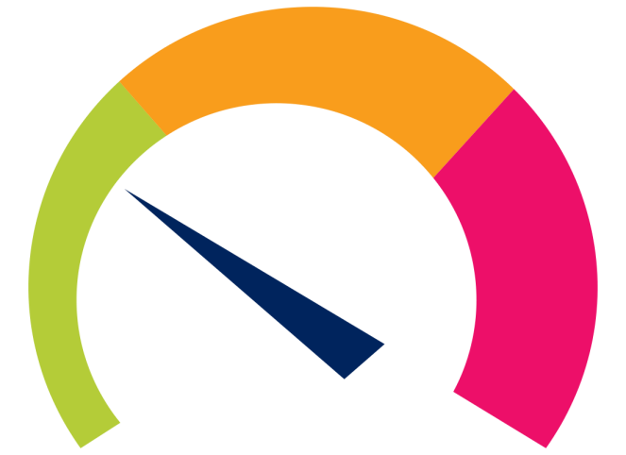
Objectives of Monitoring
Measure
Inform and Alert
Analyze
Optimize
Notes:
All in all network monitoring comes down to one thing: reliable information. Every IT Manager in the world relies on information and data to do his job. Once you have access to the right information, you can then use that data to measure and benchmark statistics, get alerted to any issues in the environment, quickly analyze and trouble-shoot the root causes and optimize the network to ensure a trouble-free IT environment.
PRTG provides information in the ways IT Managers need it: from highly detailed reports about current and historic incidents to quick overviews of downtime or top talkers in a network through to graphically aesthetic presentation of just the key indicators on an easy to read dashboard.

Slide 7
Is Your Mail Application Working?
Internet/WAN
Mailserver
Firewall
Switch/LAN
Notes:
Today‘s business processes depend on a huge amount of different components in the IT estate running correctly and in tandem.
Example:
For a user to send and receive E-Mail, you will typically require a multitude of things: a mail server such as Exchange, a switch or LAN fabric of some description, a firewall and other security devices such as anti-spam or anti-virus, and of course connection with the outside world via the Internet/WAN.
If that user then reports a problem with their email, the underlying fault could lie with any one or more of of these different things. Unified monitoring can help trouble shoot exactly what the problems are.
And even if you prefer cloud-based email, such as Google Apps, where a lot of the above mentioned infrastructure is provided for you in a data-centre, you almost certainly still have the requirement to monitor connectivity, performance, availability, end user devices etc.

Slide 8







Benefits of Monitoring
Prevent Outages
Alert of Failures
Optimize Networks
Save Money, Time and Nerves
Improve Services
Notes:
Typical challenges of IT staff
Distributed locations
Mix of heterogeneous IT environments and non-IT systems
Relieve staff
Keep an eye on all systems at all time
Create a lean and simple network

Slide 9
Available Monitoring Solutions
Entry Level Solutions
Monitoring as a Service
Unified Monitoring
Traffic Specialists
SME Demand
Coverage
APM-Solutions
Open Source
Commercial Open Source
RMM Solutions
“BIG 4 Wannabees”
“BIG 4 Wannabees”
BIG 4
Performance Ratio for SMEs
Notes:
There can’t be many specialist areas of IT with so many different vendors offering a similar thing. Here is an overview of the market, grouped into logical areas of expertise and focus.
“SME Demand Coverage” axis: Is the feature set suitable for practical purposes; does it cover the real demands of SMEs? Or is it confused with lots of unnecessary features and functionalities, that SMEs don’t need, pushing the cost up?
“Performance Ratio for SMEs” axis: Is the solution easy to evaluate, acquire, implement, use and maintain on a day to day basis?
Take some examples only!
Entry Level Solutions: Advanced Host Monitor, The Dude, NetWorx, Spiceworks
BIG 4: HP Intelligent Management Center, IBM Tivoli Netcool, CA eHealth, BMC Patrol Performance Manager
APM-Solutions: New Relic, Site24x7, SCOM, Dynatrace NPM, AppDynamics
Traffic Specialists: Scrutinizer, Capsa, Fluke, PacketShaper
„BIG 4 Wannabees“: SevOne, Statseeker, Monolith, Zenoss, OpNet, Nimsoft
Open Source: Nagios, Zabbix, Cacti, Icinga, Zenoss
RMM Solutions: Kaseya, N-able, LabTech
Monitoring as a Service: MAXfocus (GFI Max), LogicMonitor, Monitis
Commercial Open Source: Nagios XI, Op5, Watchboxx, Azeti, Zenoss
Unified Monitoring for SME: PRTG Network Monitor, WhatsUp Gold, Solarwinds NMS, OpManager

Slide 10
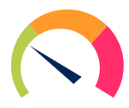
Available Monitoring Solutions
Entry Level Solutions
Monitoring as a Service
Traffic Specialists
SME Demand
Coverage
APM-Solutions
Open Source
Commercial Open Source
RMM Solutions
“BIG 4 Wannabees”
“BIG 4 Wannabees”
BIG 4
Performance Ratio for SMEs
Notes:
PRTG offers the best of both worlds for the SMB market – exactly what you need, at the right price. PRTG is the undisputed market leader in the SMB monitoring world.

Slide 11










Top 5 Selection Criteria
Ease of Daily Business
Fields of Application
Individualization
Communication
Budget
Notes:
Here is what customers need to think about when evaluating network monitoring solutions:
Ease of Daily Business: Monitoring is something you will use all day, every day. Small things therefore become big things very quickly. The solution needs to be simple to acquire, install and especially to use: with PRTG, there is no special know-how required and the solution continues to work effectively without constant user interaction
Fields of application. Think about the future too – is the monitoring tool you are considering capable of moving with the times? How?
Where will the solution be applied?
How deep and how wide does the tool need to monitor in your infrastructure?;
PRTG offers ultimate future-proofing thanks to over 15 years of experience in what’s next.
Individualization:
This is contradictory to criteria 1, it creates a lot of work and isn’t for the faint-hearted
However PRTG is a closed source software that is as open as possible to power users. Our open API and our custom script creation capabilities offer huge opportunities for scripting, customization and moulding to suit the individual requirements of every customer.
Customers can do this themselves or use our global network of certified partners to help.
The more exotic the software/hardware you want to monitor, the more flexible your monitoring tool needs to be.
Communication:
Your network monitor needs to get the right information to the right person at the right time – and nothing more.
We allow completely manual setting of triggers and thresholds so alerts are genuine and “car alarm fatigue” doesn’t set in.
Paessler is a small, agile company capable of reacting quickly to customer trends. We listen to customers carefully.
Budget:
It’s not just about procurement costs, think of ongoing costs: implementation, operation, maintenance, support, personnel.
Open source is free in the first instance, but how much will it hurt you later? What if your “Linux guy” leaves?
PRTG offers the best value network monitor with the simplest licensing model on the market .

Slide 12
PRTG – Simplifying IT Infrastructures
“Our goal is to simplify the daily work of IT professionals.
Therefore, PRTG is a monitoring solution that empowers IT professionals to manage their networks in a smart way
and to ensure that their business-critical IT infrastructure
is running smoothly with 100% uptime.”
Notes:
Our mission statement is clear.

Slide 13
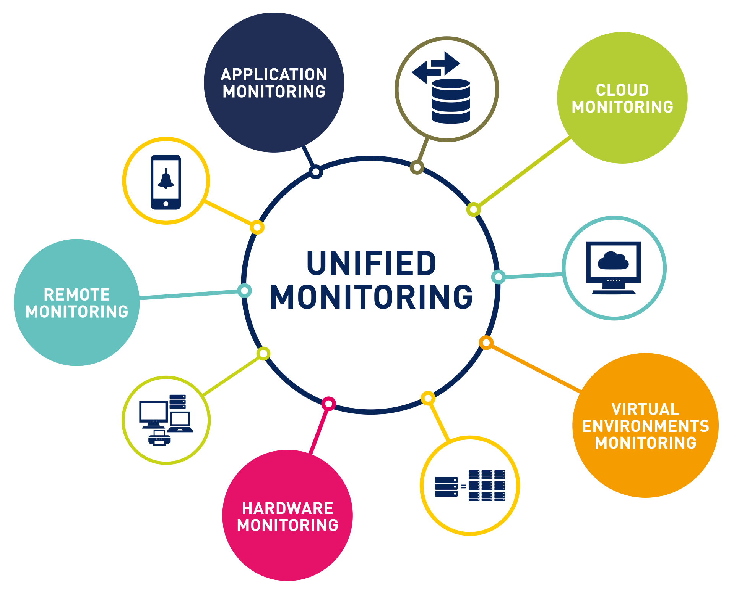
PRTG – One Solution For Everything
Notes:
User benefits:
One solution to monitor the entire IT infrastructure: hardware, applications, and virtual environments
Allows you to stop juggling multiple management solutions from multiple vendors that only provide fragmented information about their own kit, not the remainder of your overall IT infrastructure.
PRTG‘s features:
One solution to monitor everything: hardware, bandwidth, applications, clouds, virtual, environments, Internet of Things, etc.
All vendors: Cisco, VMware, Microsoft, Oracle, DELL, HP, Citrix etc.
All kinds of industries: manufacturing, government, healthcare, education, finance, professional services
All together: PRTG‘s distributed monitoring solution enables you to monitor all of your locations around the town, district, country, continent and globe.

Slide 14
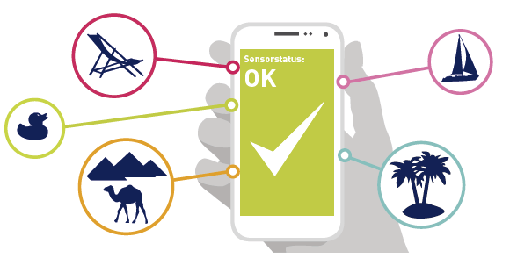
PRTG – Ease of Use
Smart Setup and Auto detection
One installer only
Proprietary database
Multiple interfaces
Detailed documentation
SMS, Email or push notifications
Notes:
User benefits:
Save time: With one installer PRTG is ready within moments → no time wasting with complex configurations
The Smart Setup identifies your entire network and helps you to ensure all devices are monitored right from the start
Later: Auto Discovery can be used to extend monitoring.
Monitor your network from anywhere, just download our mobile apps.
No need to be afraid of complicated processes within PRTG. Paessler‘s huge online knowledge base and self-paced e-learning modules are there to assist every step of the way.
Get notified right when a failure occurs through your choice of alerting method: SMS, Email, push notification and many more.

Slide 15

PRTG – All in One
Simple, fair licensing
Simple scalability
Simple updates
Notes:
User benefits:
PRTG comes will all features included in every license → no surprises, no add-ons, no extra cost
Scale your monitoring as you grow. Upgrade from smaller to larger licenses simply by paying the difference between the two – no penalty!
Continuous roll-out automatically updates your software so your network is constantly monitored with the most cutting-edge technology

Slide 16

Craft Your own PRTG
Notes:
User benefits:
PRTG‘s powerful open API allows you to simply implement your own scripts and tailor your installation to your needs
Develop custom sensors and adapt PRTG to your individual infrastructure
Set up simple or advanced dashboards with PRTG‘s own maps creator. See immediately what the problem is, and be able to react quickly.
Optimize your network and enable effective asset planning by analyzing historical data provided by PRTG.

Slide 17
PRTG Architecture
Notes:
PRTG Network Monitor consists of three components:
- Core Server
- Probes
- Sensors
The core server is the heart and soul of PRTG: it stores, analyzes and publishes data graphically as reports and maps/dashboards. In addition, it handles alerting and notifications, to ensure that you can respond quickly to problems in your infrastructure. All data is stored in a custom database, specially optimized for storing monitoring results, to permit efficient access from multiple user interfaces (the Web UI, Enterprise Console, and mobile apps).
The probes are either local or remote, allowing simple inclusion of 3rd party networks or remote office locations etc. They gather status data from your devices and send the results to the core server for analysis. You can use multiple probes at multiple distributed locations with a single core server license. All communication between the remote probes and the core server is encrypted with SSL.
PRTG comes with 225+ sensor types out of the box and customers can also easily create their own sensors for anything particularly “exotic” in their network.

Slide 18
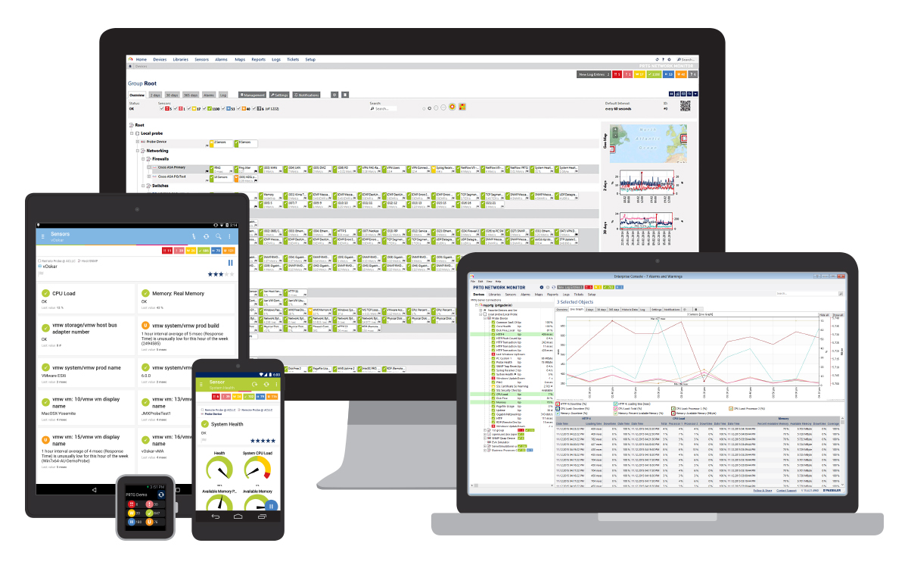
Choice of User Interface
Notes:
The Web GUI at the rear of this graphic is the most feature-rich and used by the majority of customers.
Enterprise Console on the right is a Windows application that aggregates multiple separate core servers and allows single pane of glass management and consolidated dashboard data.
Otherwise we also natively support iOS, Android, Windows phone and Blackberry. For any other small form factor devices we use mini-HTML.

Slide 19
Areas of Application

Slide 20
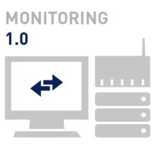
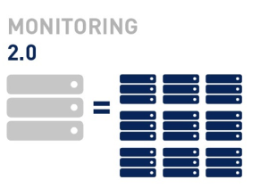
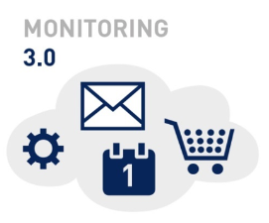
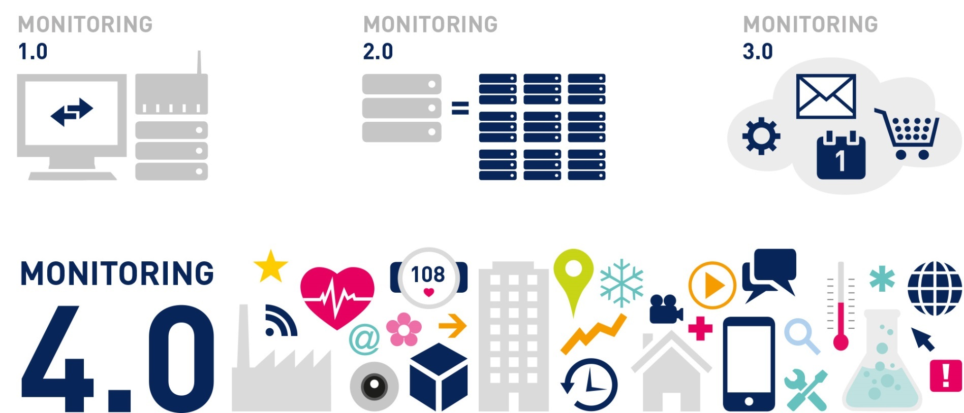
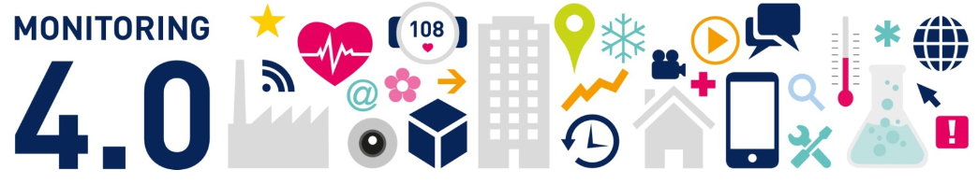
Evolution of Monitoring
Notes:
Before going into detail about PRTG‘s fields of application, the evolution of monitoring needs to be clarified
Since Web 2.0 things get „versionized“ willingly (e.g. industry 4.0). Therefore monitoring needed to get its own versions, as well
1.0 – only main things monitored such as physical hardware and direct attached storage
2.0 – increasing virtualization led to the second stage of VM aware monitoring, increased use of shared storage and more centralised IT environments
3.0 – as a result of constantly integrating the cloud to daily business, universal monitoring is now needed to ensure guaranteed access to software-as-a-service solutions and on-premise solutions running together
4.0 – The next stage is to include monitoring of previously non-IT-related assets such as estate management solutions, physical security, air con, lighting, IP newcomers like voice, tv etc., even internet enabled fridges, coffee machines, shrimp farms, blood fridges and so on...

Slide 21
PRTG in the Industrial Internet
Notes:
Please select the slides pertaining to the applicable industry vertical focus for your audience.

Slide 22

Industrial I(o)T: Challenges
Separation between classic and production IT
Classic IT does not support machinery protocols
Integration is essential to create smart factories
Notes:
Industrial Internet of Things and Classic IT infrastructure have always been separated due to security reasons and differences in languages (protocols etc.)
Machinery operates on protocols that are not supported by classic information technology
However: integration of classic and production IT hard- and software is essential for creating smart factories and manufacturing processes

Slide 23

Industrial I(o)T: What is Necessary?
Notes:
Successful IoT environments need a central control panel that is able to monitor and graphically depict both generic IT environments and smart production facilities at the same time
Therefore a flexible monitoring solution, incl. the following features is necessary:
Support established IT monitoring standards
Documented interfaces to integrate production relevant systems
Means for efficient illustrations of gathered data
Notification and reporting features
Support multiple site monitoring without additional cost
Simplicity in its entirety in order to reduce employee training requirements

Slide 24
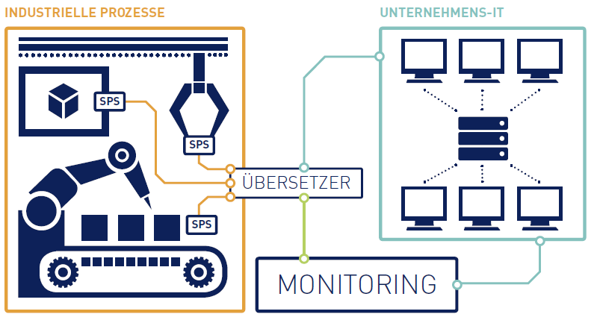
PRTG - Connecting Production and IT
Notes:
PRTG Network Monitor as a connecting point between production and classic IT environments:
We supports all established protocols for monitoring IT infrastructures (SNMP, Net Flow, WMI, http etc.)
You can integrate industrial processes via translators that also measure PRTG-readable data
(important: the translator is not a PRTG product, but partner hardware, individualization normally not necessary)
It is more easy, when a new/modern system is available over an interface to IT environments with standard protocols.
Simpler examples include translating building control systems such as lighting, security and air con systems onto SNMP. Air con failure is a big problem. Also generator leaks, fuel levels, heat and moisture levels, salinity of shrimp farms, jackpot levels in a casino!

Slide 25
PRTG in Healthcare

Slide 26
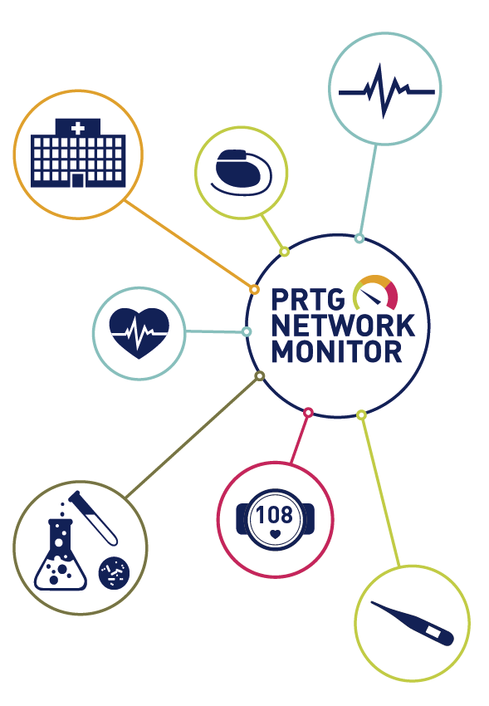
IT Challenges in Healthcare
24/7 availability of the entire infrastructure
Network functionality is maintained from distributed locations
Hospital environments peak in complexity
Notes:
Challenges in hospitals:
When saving a human life, every second counts. All IT assets, medical staff and technology need to work perfectly all the time.
The hospital works 24x7 which means the systems have to be available 24/7
However: IT staff does not always, unlike medical employees, work at night or weekend
Some facilities maintain functionality of networks across distributed locations
Hospital environments peak in complexity:
A vast number of integrated components as well as special requirements need extraordinary treatment and are mostly unusual in typical IT networks

Slide 27
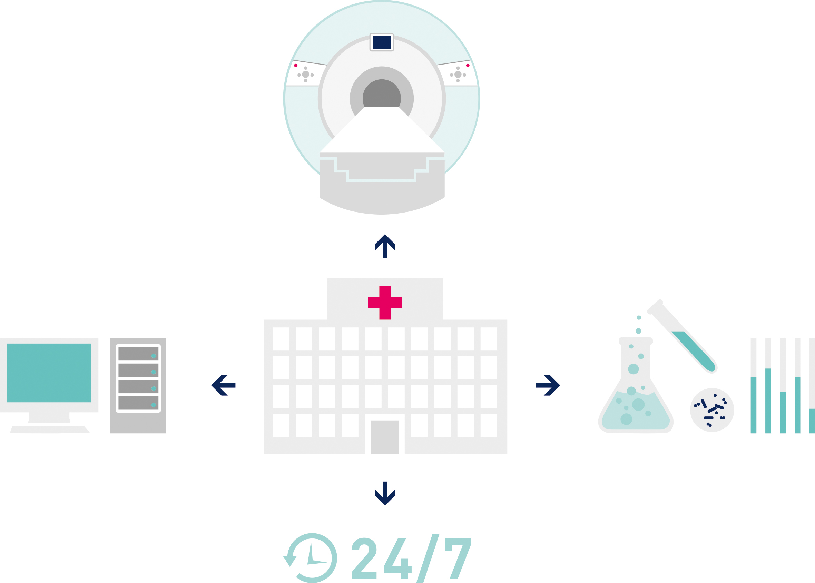
IT Requirements in Healthcare
Notes:
Customer needs:
State-of-the-art information technology serving classic IT infrastructures as well as fully-electronic patient medical records and equipment
Furthermore: Possible to integrate a group-wide practice management system relying on interoperable systems and third parties
Picture special scenarios, e.g. Interface monitoring (KIS/LIS/RIS, external report..)
PRTG supports DiCOM and HL7 protocols
Highest security standards to protect sensitive data
Proactive identification of IT or network problems
Reliable and customizable notification system, triggered by unusual occurrences, malfunctions or even failures
Appropriate illustration of current network status via customizable dashboards
IT and non-IT elements need to be centrally monitored in a hospital infrastructure (X-Ray/CT/MRI, Fridges for blood and pharmaceuticals, backup power supply system/ heat and power station, OR equipment)

Slide 28
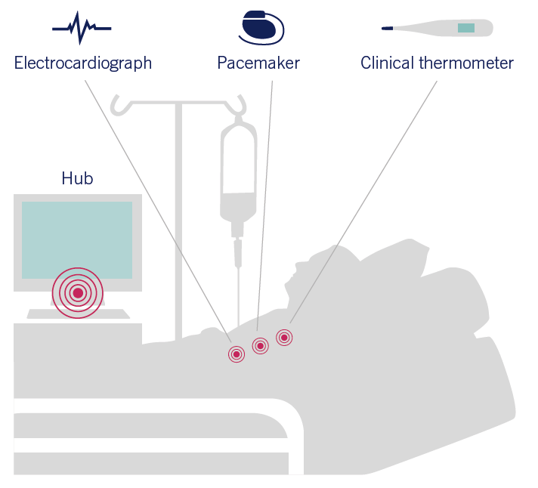
PRTG - A Life Saver
Check Out PRTG‘s
eHealth Sensors!
Notes:
Integrating a powerful network monitoring solution will not only support saving lives during daily business it also increases efficiency and saves time
All connected data can be used to optimize processes, resulting in less expenses for maintenance or redundant equipment
→ Network admins are easily able to identify real needs, justify upgrades and critical IT investments
24/7 vs. 5x8: With PRTG and its remarkable alerting system via email, SMS or push-notification, IT teams can monitor around the clock without being present all the time.
Furthermore by launching eHealth Sensors, PRTG becomes even more powerful with regard to monitoring hospital IT environments: https://www.paessler.com/blog/2016/04/13/all-about-prtg/ehealth-sensors-know-what-is-going-on-in-your-medical-it
In brief: A central monitoring solution can help considerably to improve the quality of patient care by ensuring that the entire hospital infrastructure is working efficiently at all times

Slide 29
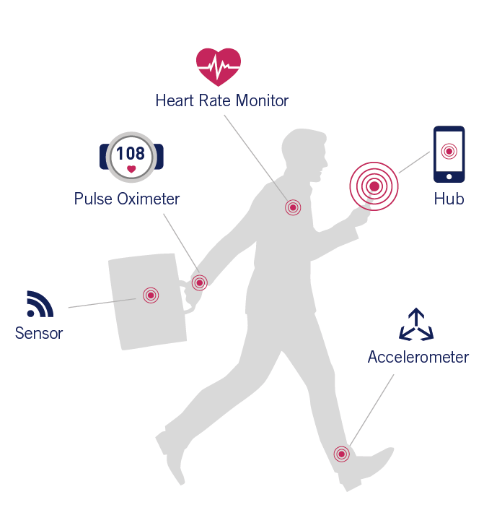
PRTG: Connects Patient and Provider
Skyrocketing trend of mobile healthcare devices
Need for more accessible and less expensive healthcare services
Remote communication, diagnosis, treatment and monitoring via connected health
Notes:
Connected health
The increasing life-style trend of using mobile healthcare devices and connecting those to a smartphone results in…
Rising competition in healthcare industry, demanding more effective healthcare delivery
→ Need for more accessible and less expensive healthcare services by enabling patient-provider connectivity anytime and anywhere
So-called connected health is a digital and technology enabled integrated care delivery, allowing remote communication, diagnosis, treatment and monitoring
The growing digitalization of the healthcare sector is boosting the demand for smoothly running networks
PRTG can become a critical part in providing best services to healthcare clients

Slide 30
PRTG in Government and Education

Slide 31
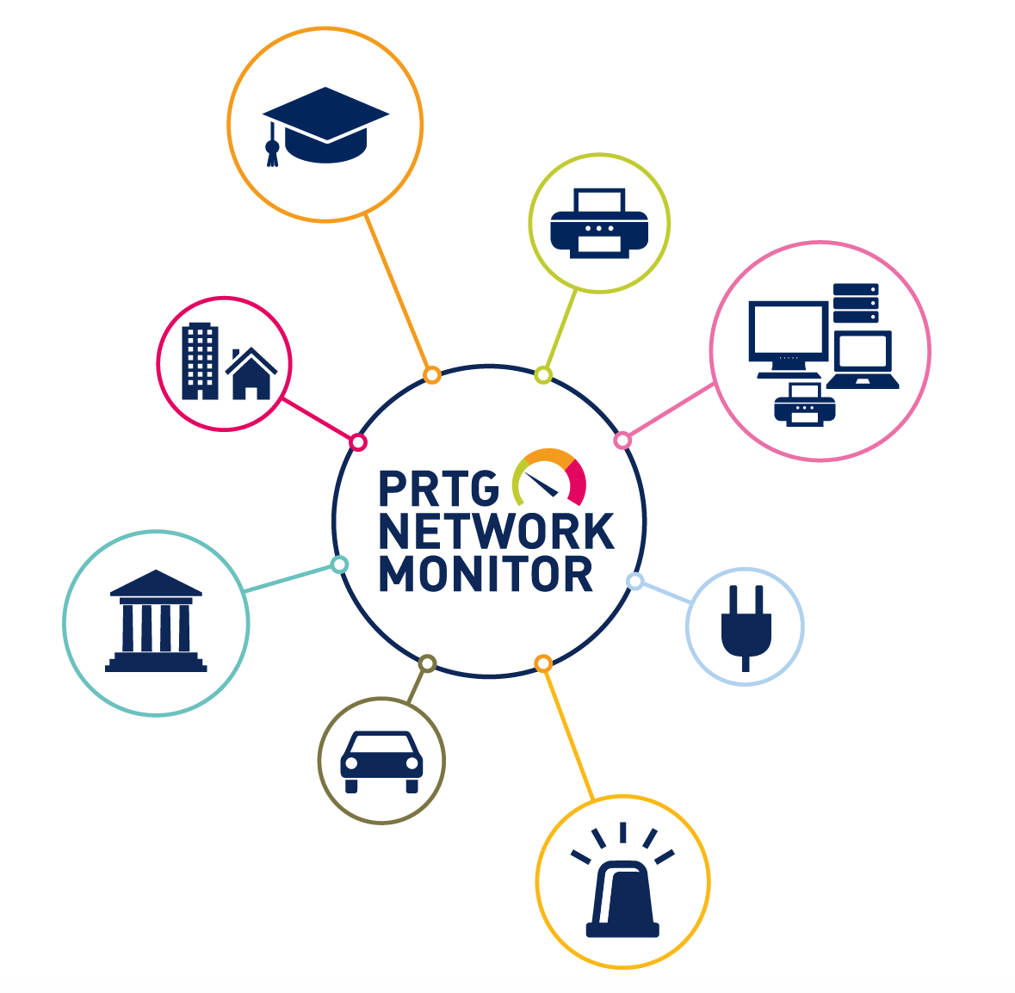
Education & Government: Challenges
Notes:
Challenges:
Distributed IT environments in educational and public institutions
Devices need to be able to exchange data and communicate all the time
Online services need to be available around the clock
High burdens caused by full availability of all systems → working in shifts → though for smaller institutions with limited financial and human resources
Heterogeneous infrastructure
Financial limitations lead to partial or batch-wise updates of IT environments → Network Management becomes even more difficult
Sensitive data needs to be protected 24/7
Due to IoT development more non-IT devices become smart, such as fridges, air conditioners etc. and need to be surveilled
A central overview of the entire IT infrastructure from all different systems and locations is needed
Modern Education:
Classrooms, lecture halls and research labs experience tremendous digitalization
E-Learning, tablet use and augmented reality in education will soon become daily routine and increase dependency on reliable networks
Critical IT issues might prevent students from accessing course material, endanger research projects, paralyze school administrators
We offer a 15% discount off RRP for education, government and charity/non-profit.

Slide 32
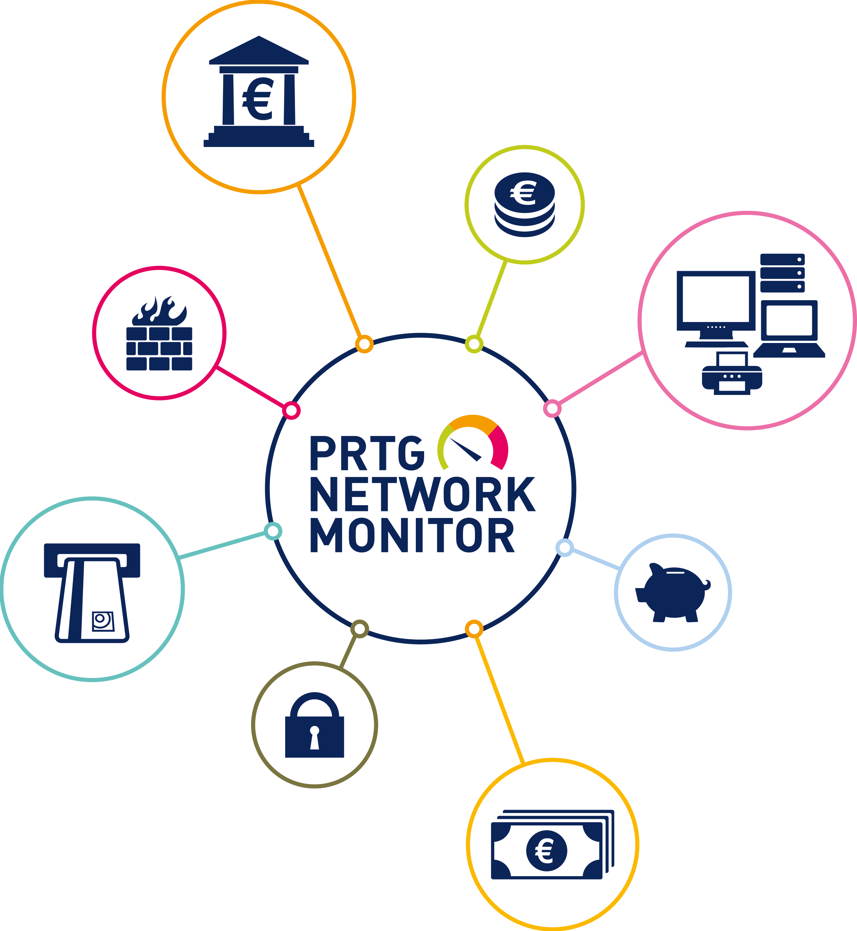

Additional Areas Where PRTG Fits Well
Finance
Ensuring a safe flow of money
Energy
A smooth supply with PRTG
Notes:
Monitor distributed locations
PRTG comes with remote probes gathering data for each individual site and sends the data via SSL encryption to a central instance.
Monitor heterogeneous IT environments and non-IT systems
Providing sensors for all devices and applications on the market is impossible
PRTG contains however more than 200 sensors including custom ones and script examples
Furthermore it supports established standards such as SNMP, WMI, Flow, packet sniffing etc.
Relieve your staff
PRTG takes care of your institutions network 24/7
In case of any outage it will immediately notify your system administrators
Keep an eye on all systems, all time
PRTG monitors all locations and systems and displays them on a central dashboards
It is easy to create custom HTML Maps, delivering a comprehensive overview of complex infrastructures
Continuously optimize your network
Analyzing historic data leads to assessing an IT infrastructure’s state
Basis for medium- to long-term optimization
In brief: PRTG Network Monitor combines efficient and uncomplicated monitoring of distributed locations and vendor neutral monitoring if different devices and applications

Slide 33
Cost Effective, Lean and Simple
PRTG License
Freeware Edition
PRTG Network Monitor 500
PRTG Network Monitor 1000
PRTG Network Monitor 2500
PRTG Network Monitor 5000
PRTG Network Monitor XL1
PRTG Network Monitor XL5*
Sensors
100
500
1000
2500
5000
not restricted
not restricted
RRP US$
free
US$ 1,600
US$ 2,850
US$ 6,150
US$ 10,500
US$ 16,900
US$ 60,000
RRP €
free
€ 1,200
€ 2,150
€ 4,500
€ 8,000
€ 12,900
€ 45,000
For MSPs: All PRTG licenses from the free 100 sensor license up to the PRTG XL5 license include the entire MSP feature set.
*The PRTG XL5 allows to install PRTG on up to 5 servers worldwide.
Notes:
All available licenses in detail. Things to mention:
PRTG 100 is not an advert riddled freeware, it’s a commercial license that is free of charge to seed the market.
One sensor is an individual entity of measurement, like CPU usage or hard disk capacity. Very approximate ratio to devices is x10.
No penalty for upgrade: As soon as your current license has become too small, just upgrade by paying the difference between two licenses
All-in pricing = no separate modules or plug-ins.
5% built-in discount for purchasing 2 years’ maintenance and support up front, 10% for 3 years
Annual maintenance price includes regular software updates and direct vendor support
PRTG Network Monitor XL 1 is officially unrestricted in terms of number of sensors, however our best practice guidelines, system recommendations and support restrictions do apply: https://www.paessler.com/prtg/requirements.

Slide 34


Get Active and Contact us!
Company Name
Add logo here
Street
Phone:
Fax:
Email:
Web:
Add certifications and partner level here
e.g. Certified Monitoring Expert, Sales Professional
Notes:
This is where you as a partner put your traceable TRIAL-Key, company logo, and contact details
Link Trial-Key to the Banner „Free Trial“: You can find an instruction on how to create a campaign trial key in your partner portal

Slide 35
Additional Content
(If necessary)

Slide 36



The Company
Headquartered in Nuremberg, Germany
Founded in 1997
190 staff (and counting...) from 25 different nationalities
Privately held and funded
Over 200,000 installations worldwide
Notes:
100% owned by founders and employees
Development and support from Germany – completely company internal
US sales team for the North American market
For 15 years 25 to 60% constant annual growth
More than 200.000 installations in more than 120 countries
Companies in all sizes and branches are clients
More than 70% of the Fortune 100 companies in the world use PRTG
Authorized partners all over the world

Slide 37
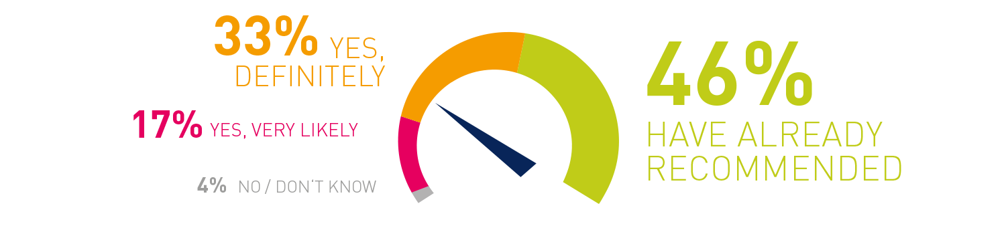
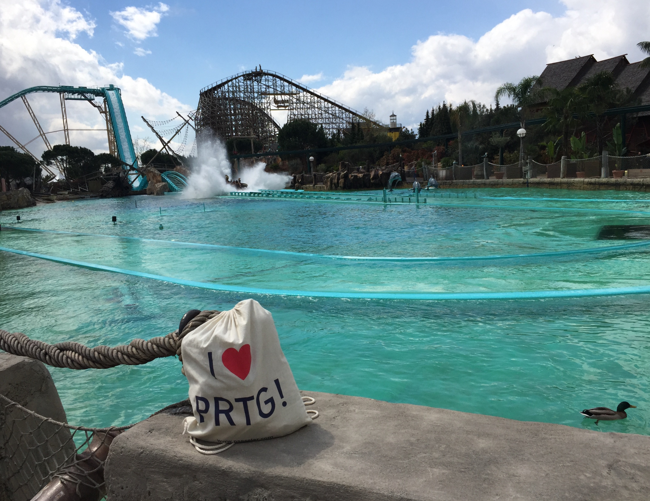
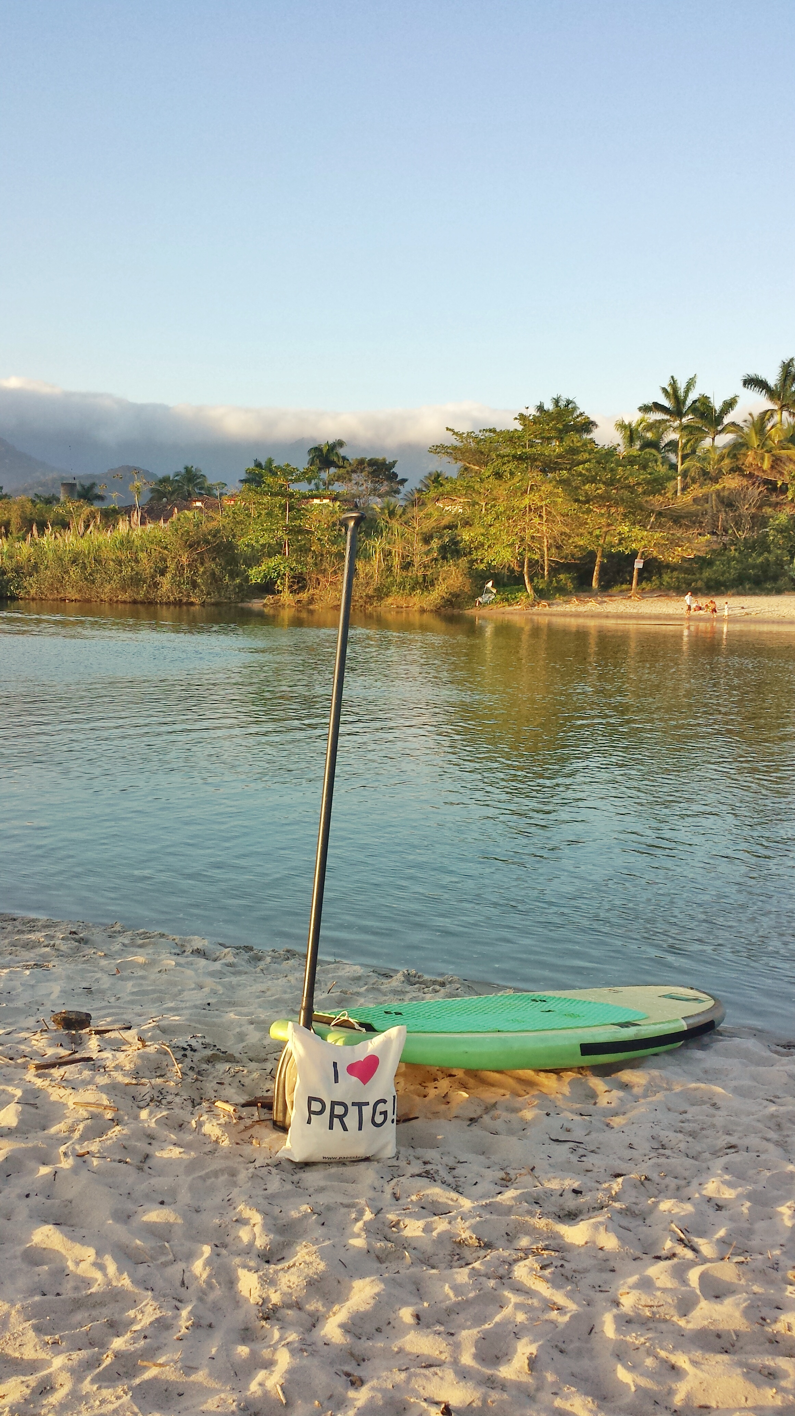


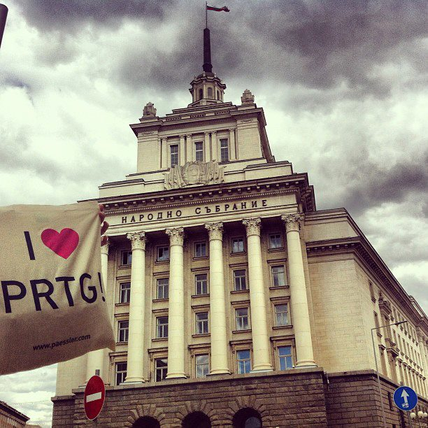
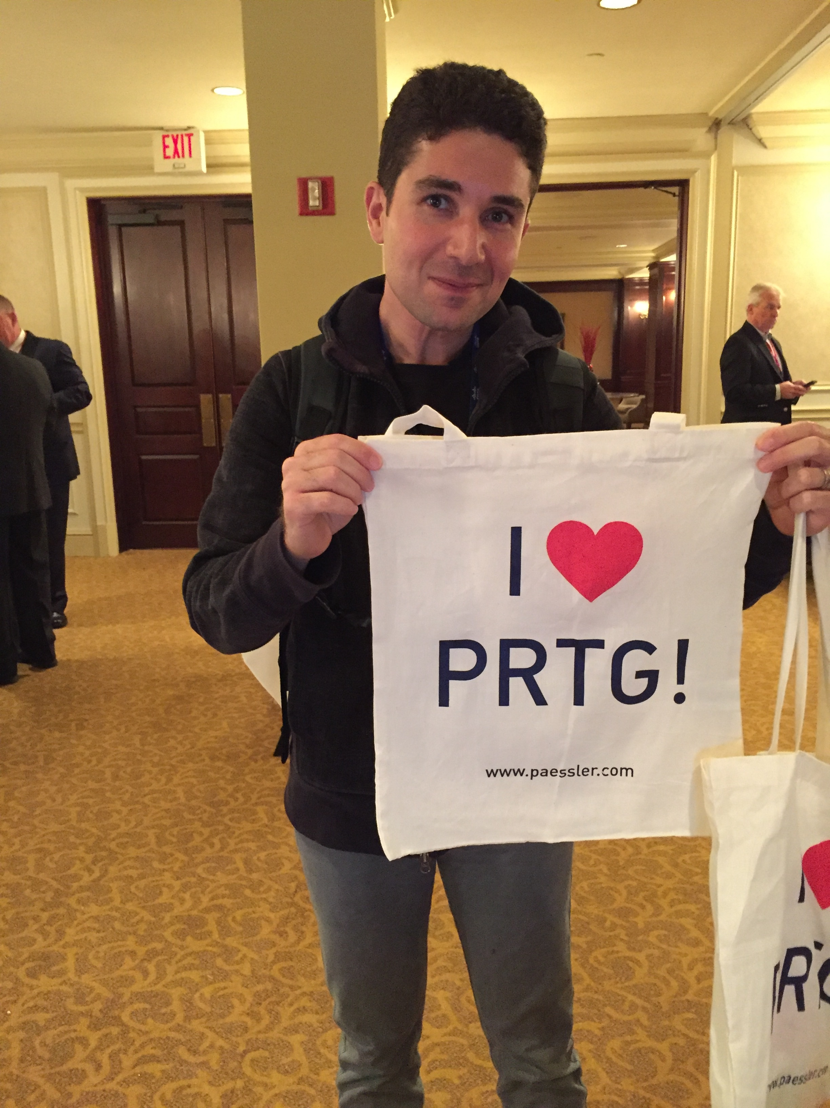
Would You Recommend
PRTG to Colleagues?
Notes:
We don’t have customers, we have fans! Our community is strong – we held a social media campaign for customers to take photos of a PRTG bag in the strangest place they could.
97% of customers would recommend PRTG to their peers.

